Slide 1
The European Public Prosecutor’s Office (EPPO) the first transnational prosecutor’s office protecting the financial interests of the EU by means of criminal law
Alessandro DI TARANTO
European Delegated Prosecutor
Office of Rome

Slide 2
Legal basis
PIF Directive(EU) 2017/1371 on the fight against fraud to the Union's financial interests by means of criminal law.
EPPO Regulation (EU)2017/1939, implementing enhanced cooperation on the establishment of the European Public Prosecutor’s Office (‘the EPPO’)
National level: Italy- D.L.vo 9/2021

Slide 3
EPPO – main features
EPPO is a supranational and independent body of the European Union (EU);
Independent:
from others European authorities (Commission and Parliament);
from national authorities, including the national prosecutorial and judicial authorities;
Single office with:
a central level based in Kirchberg, Luxembourg City, alongside the Court of Justice of the European Union (CJEU) and the European Court of Auditors
a decentralised level: European Delegated Prosecutors (EDP), fully members of the EPPO, operating in each one of the 22 Member States participating in the EPPO

Slide 4
EPPO – main features- participant MS
Austria | Finland | Luxembourg | Slovenia
Belgium | France | Malta | Spain
Bulgaria | Germany | Netherlands
Croatia | Greece | Poland
Cyprus | Italy | Portugal
Czech Republic | Latvia | Romania
Estonia | Lithuania | Slovakia
EDPs do not use MLA tools during investigations in others participant member states, because EPPO is a single office.
Non participant MS: Hungary, Sweden, Ireland, Denmark

Slide 5
EPPO – main features
COMPETENCE
Exclusive competence for investigating, prosecuting and bringing to judgment “PIF offences”, up the final judgement (until the case has been finally disposed of) – any offence that could affect the financial interest of the EU.

Slide 6
EPPO – main features
COMPETENCE
"PIF Directive" (EU) 2017/1371 on the fight against fraud to the Union's financial interests by means of criminal law.
Article 2
Definitions and scope
(...)‘Union's financial interests’ means all revenues, expenditure and assets covered by, acquired through, or due to:
(i) the Union budget;
(ii)the budgets of the Union institutions, bodies, offices and agencies established pursuant to the Treaties or budgets directly or indirectly managed and monitored by them;

Slide 7
EPPO – main features
COMPETENCE
"PIF Directive" (EU) 2017/1371 on the fight against fraud to the Union's financial interests by means of criminal law.
Article 2
Definitions and scope
(...) "In respect of revenue arising from VAT own resources, this Directive shall apply only in cases of serious offences against the common VAT system", I.E.:
where the crime is connected with the territory of two or more EU Member States;
Where the crime involves a total damage of at least EUR 10,000,000."

Slide 8
EPPO – main features
COMPETENCE
"PIF Directive" (EU) 2017/1371 on the fight against fraud to the Union's financial interests by means of criminal law.
Article 3
Fraud affecting the Union's financial interests
Fraud in respect of non-procurement-related expenditure:
Claiming EU subsidies with false declaration
Submitting inflated additional costs, false statement
Manipulating financial statements
Claiming and receiving double funding

Slide 9
EPPO – main features
COMPETENCE
"PIF Directive" (EU) 2017/1371 on the fight against fraud to the Union's financial interests by means of criminal law.
Article 3
Fraud affecting the Union's financial interests
Fraud in respect of procurement-related expenditure;
Submitting false declarations;
Submitting false documents;
Collusive bidding, manipulation of tenders;
Intentional splitting;

Slide 10
EPPO – main features
COMPETENCE
"PIF Directive" (EU) 2017/1371 on the fight against fraud to the Union's financial interests by means of criminal law.
Article 3
Fraud affecting the Union's financial interests
VAT revenue fraud;
Carousel fraud;
False declarations;
Abuse of customs procedure 42;
VAT fraud committed by private persons.

Slide 11
EPPO – main features
COMPETENCE
"PIF Directive" (EU) 2017/1371 on the fight against fraud to the Union's financial interests by means of criminal law.
Article 3
Fraud affecting the Union's financial interests
NON –VAT revenue fraud (customs and antidumping duties fraud);
Submission of incorrect customs declarations;
False import customs declarations;
Importation of e-bikes.

Slide 12
EPPO – main features
COMPETENCE
"PIF Directive" (EU) 2017/1371 on the fight against fraud to the Union's financial interests by means of criminal law.
COMMON CRIME= CORRUPTION
Public procurement procedures, in particular, have been found to be at risk of corrupt activity by public officials, either in their capacity as members of evaluation panels or through illicit attempts to influence decision-making in such procedures
Bribery of project officials in exchange for the:
awarding of EU funds to specific project/service proposal;
Approval of ineligible and inflated additional costs in the project execution phase;
Bribery of a public official in return for influencing an ongoing EPPO investigation.

Slide 13
EPPO – main features
COMPETENCE
Article 22 EPPO Regulation (2017/1939):
Criminal offences affecting the financial interests of the Union that are provided for in Directive (EU) 2017/1371, irrespective of the legal qualification under national law.
Organised crime, if the focus of the criminal activity is to commit any of the "PIF offences".
Inextricably linked offences, and money laundering involving property derived from "PIF offences".
VAT Fraud: connected with the territory of two or more Member States and involve a total damage of at least EUR 10 million.

Slide 14
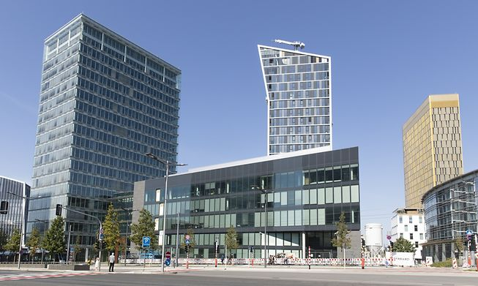
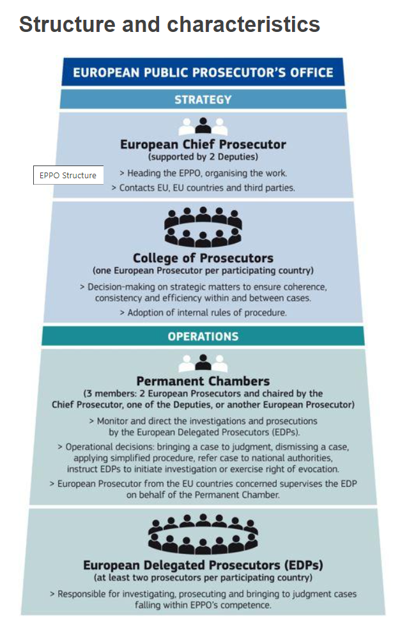
Structure
Central level:
the European Chief Prosecutor ECP;
22 European Prosecutor (1 for each Member State) EPs
the Administrative Director
College of Prosecutors: ECP +EPs
(decision-making on strategic matters + adoption of internal rules of procedure)

Slide 15
Structure
Central level:
15 Permanent chambers: (3 EPs):
Monitor and direct the investigations and prosecutions by the EDPs;
Operational decision;
European Prosecutor from the EU MS concerned supervises the EDP on behalf of the Permanent Chamber;

Slide 16
Structure
Decentralised level:
National level (22 MS)
140 European Delegated Prosecutors (EDPs)
Responsible for investigating, prosecuting and bringing to judgment cases falling within EPPO's competence (trials before the Courts of each MS)

Slide 17
Cross-border cases
Investigation measures – principles – Art. 31
Acting as a single office, not use MLA with other EPPO MS;
EDPs acting in close cooperation by assisting and regularly consulting each other
Immediate involvement of the central level
Handling EDP assign the measure to a EDP located in the Member State where the measure needs to be carried out

Slide 18
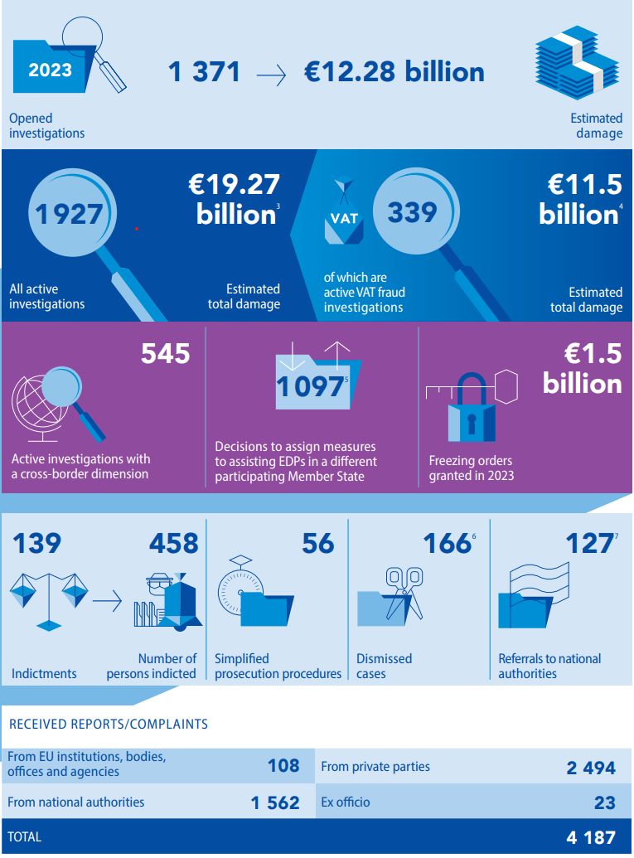
SOME DATA (ANNUAL REPORT 2023)
By 31 December 2023, EPPO had 1927 active investigations;
17.5% of them were into VAT fraud for estimated damages of EUR 11.5 billion;
28.2% of them had a cross-border dimension

Slide 19
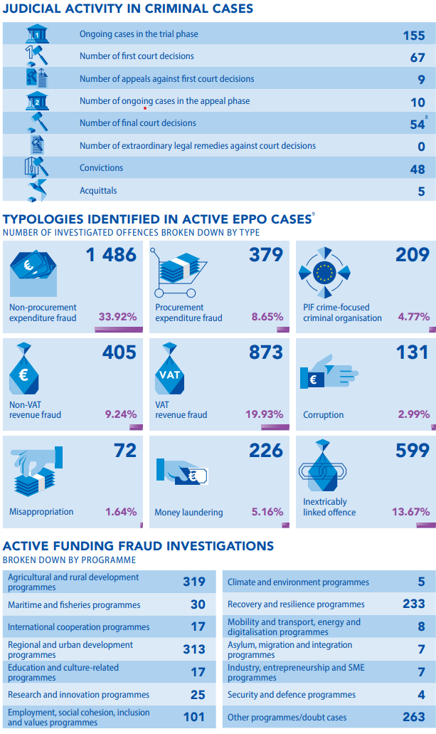
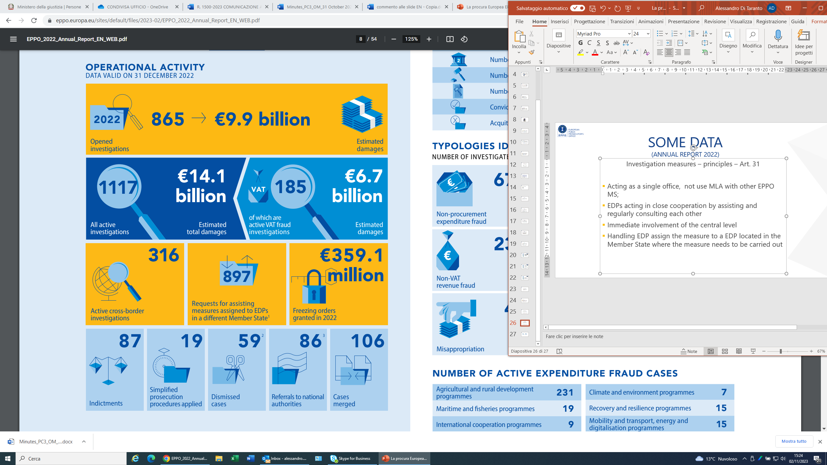
SOME DATA (ANNUAL REPORT 2023)
By 31 December 2023, EPPO had:
155 Ongoing cases in the trail phase;
54 final court decision;
48 convictions;
1.486 Non Procurement expenditure fraud (33,92%)

Slide 20


Thank you for your attention!

